Slide 1
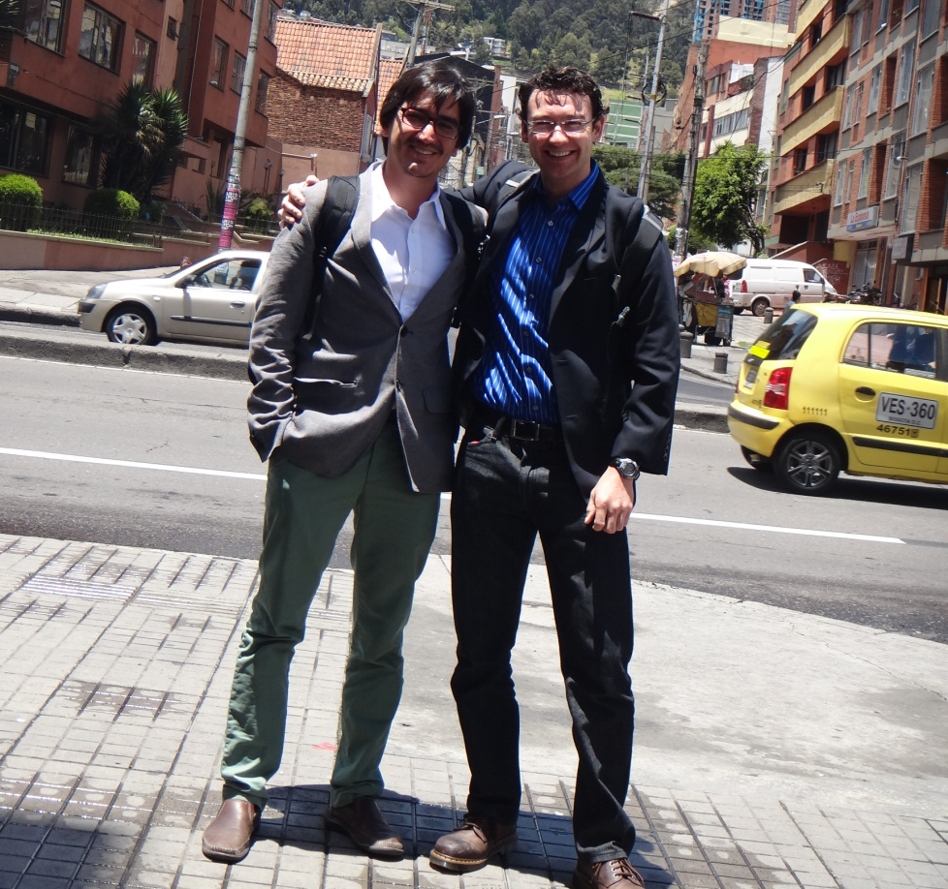
SGA Mentoring Scheme Experience
Brian Kastl (Mentee) and JuanSe Sebastian Lozano (Mentor)
October 27, 2014

Slide 2
Ecosystem Assessment Tools
Integrated Valuation of Environmental Services and Tradeoffs (InVEST)
  Sediment Retention
  Nutrient Retention
Resource Investment Optimization System (RIOS)

Slide 3

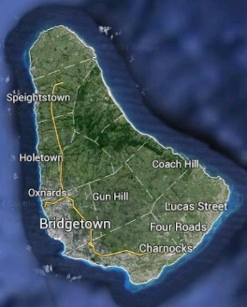

Slide 4
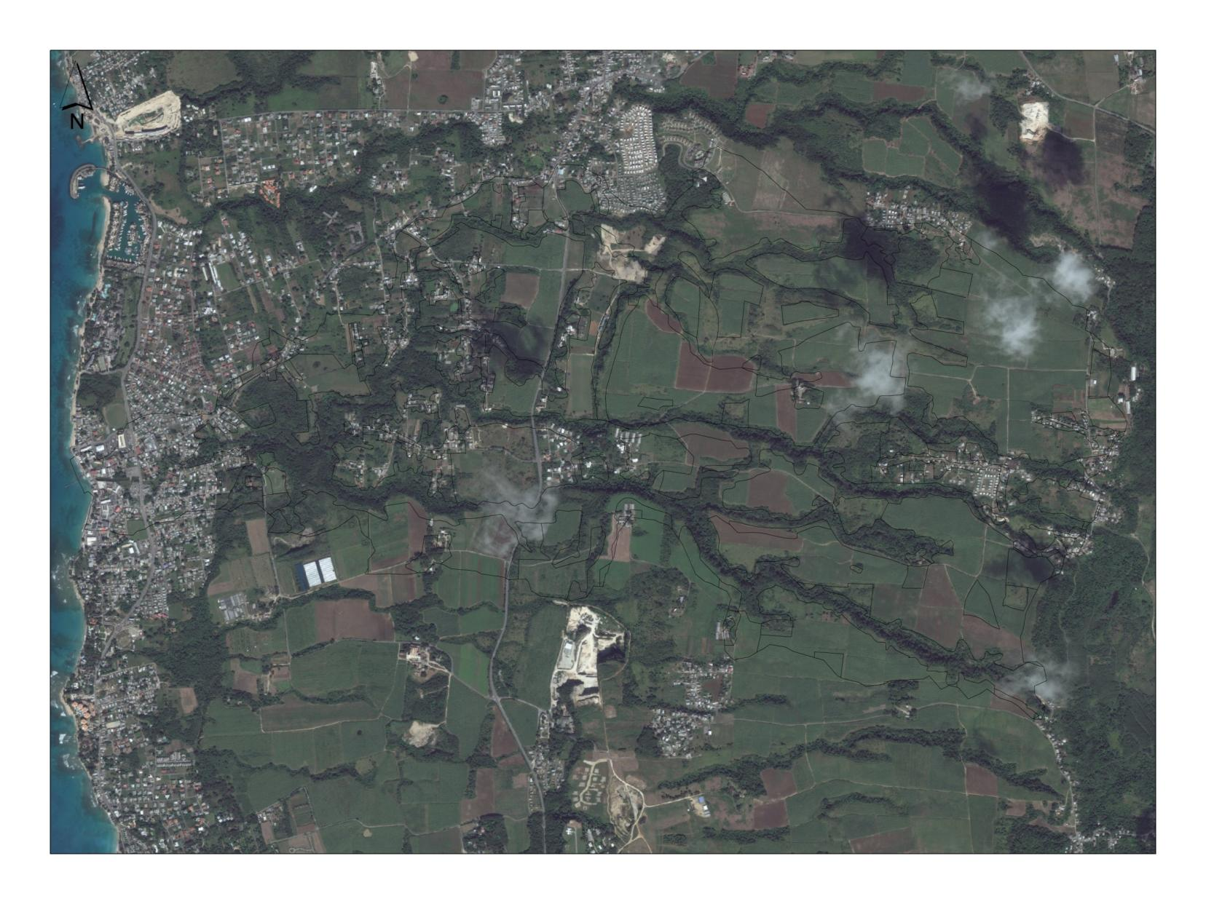
2 km

Slide 5
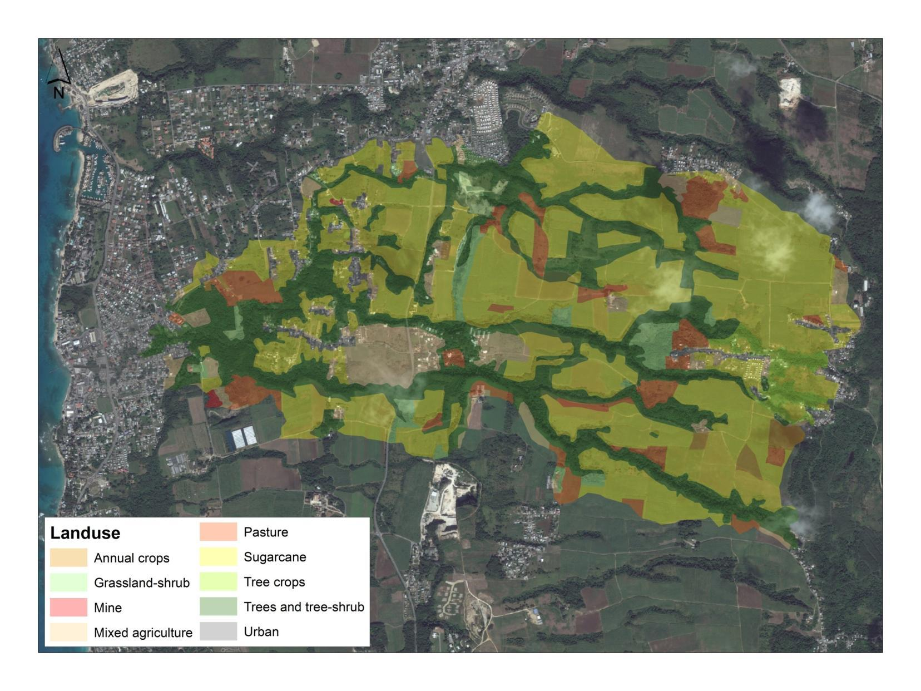

Slide 6
Water Purification: Nutrient Retention
Pollutant input
Y
corn
forest
wheat
forest
Stream
Courtesy Adrian Vogl

Slide 7
Water Purification: Nutrient Retention
Pollutant input
Retained pollutant
Y
corn
forest
wheat
forest
Stream
Courtesy Adrian Vogl

Slide 8
Water Purification: Nutrient Retention
Pollutant input
Y
corn
forest
wheat
forest
Stream
Courtesy Adrian Vogl

Slide 9
Water Purification: Nutrient Retention
Pollutant input
Y
corn
forest
wheat
forest
Stream
Courtesy Adrian Vogl

Slide 10
Water Purification: Nutrient Retention
Y
corn
forest
wheat
forest
Stream
Courtesy Adrian Vogl

Slide 11
Y
corn
forest
wheat
forest
Stream
Courtesy Adrian Vogl

Slide 12
Water Purification: Nutrient Retention
service
Y
corn
forest
wheat
forest
Stream
Courtesy Adrian Vogl

Slide 13
Water Purification: Nutrient Retention
service
Y
corn
forest
wheat
forest
Stream
Courtesy Adrian Vogl
Cumulative Nutrient Loading(CNL)

Slide 14
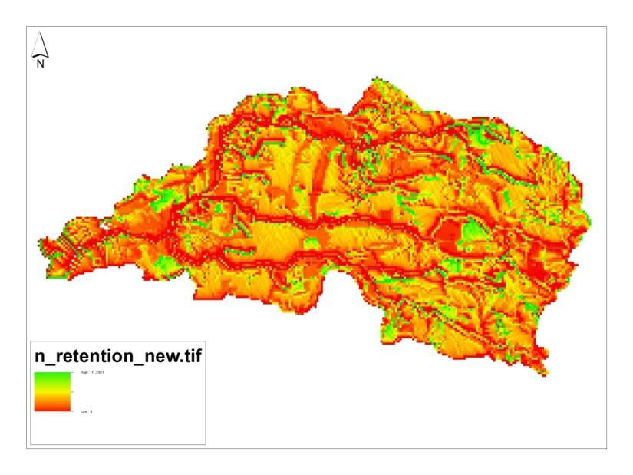
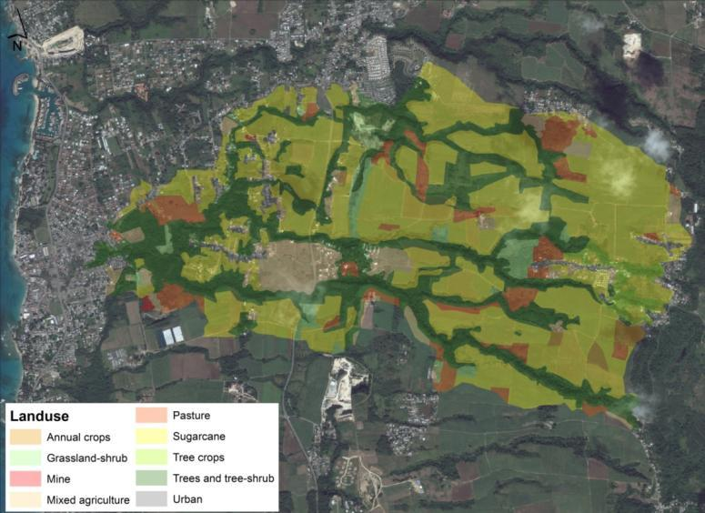
Nitrogen Retention Results

Slide 15
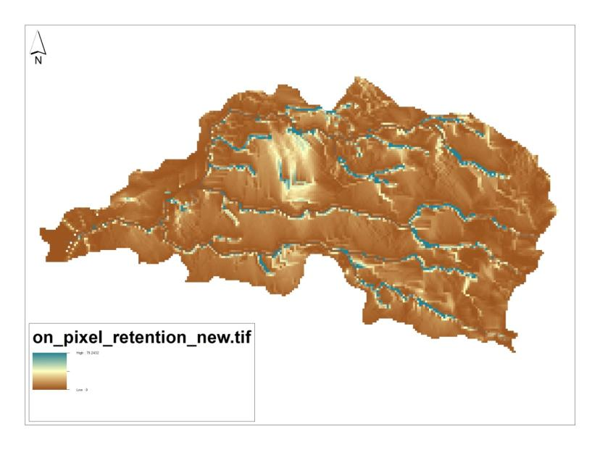
Sediment Retention Results

Slide 16
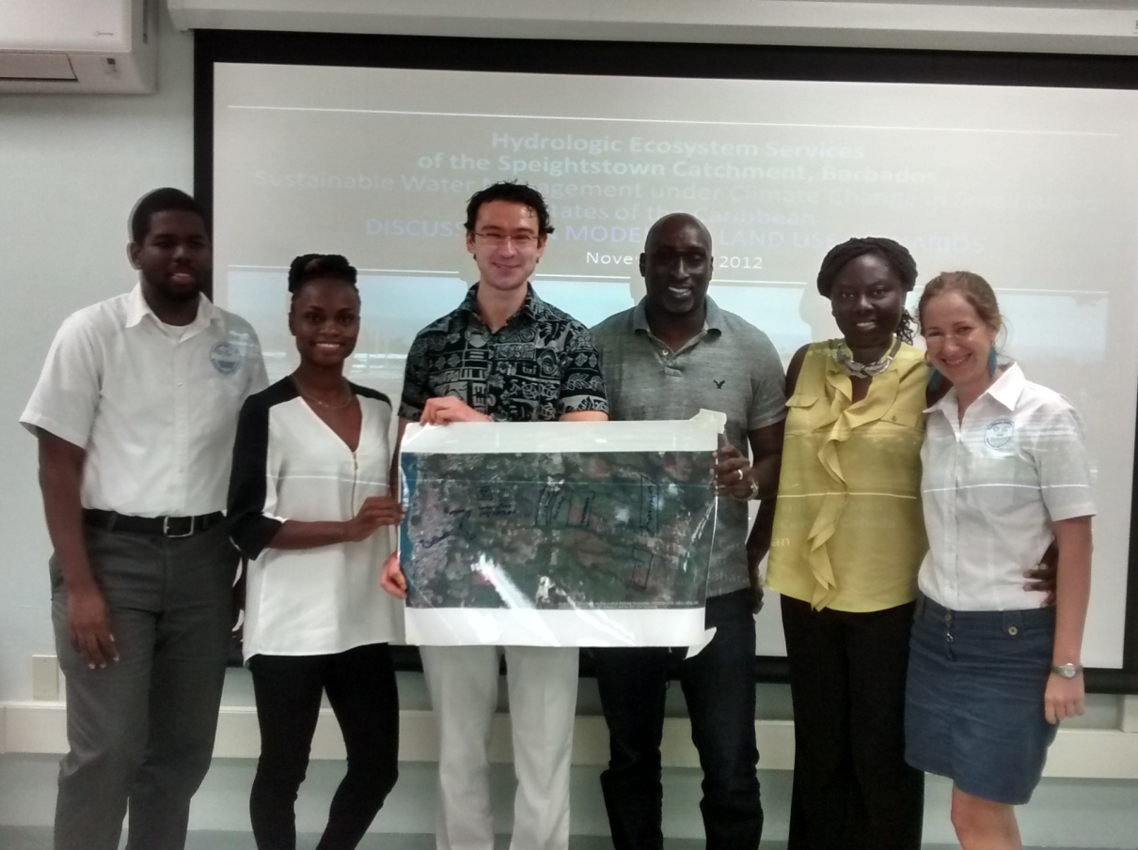
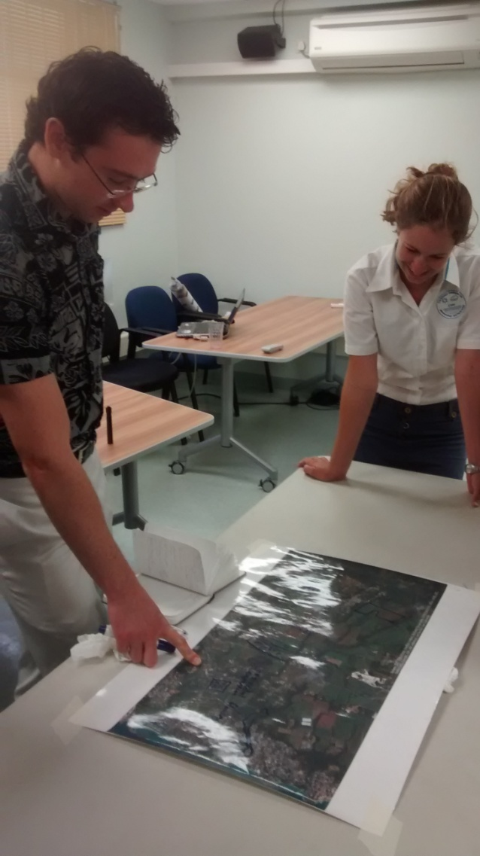
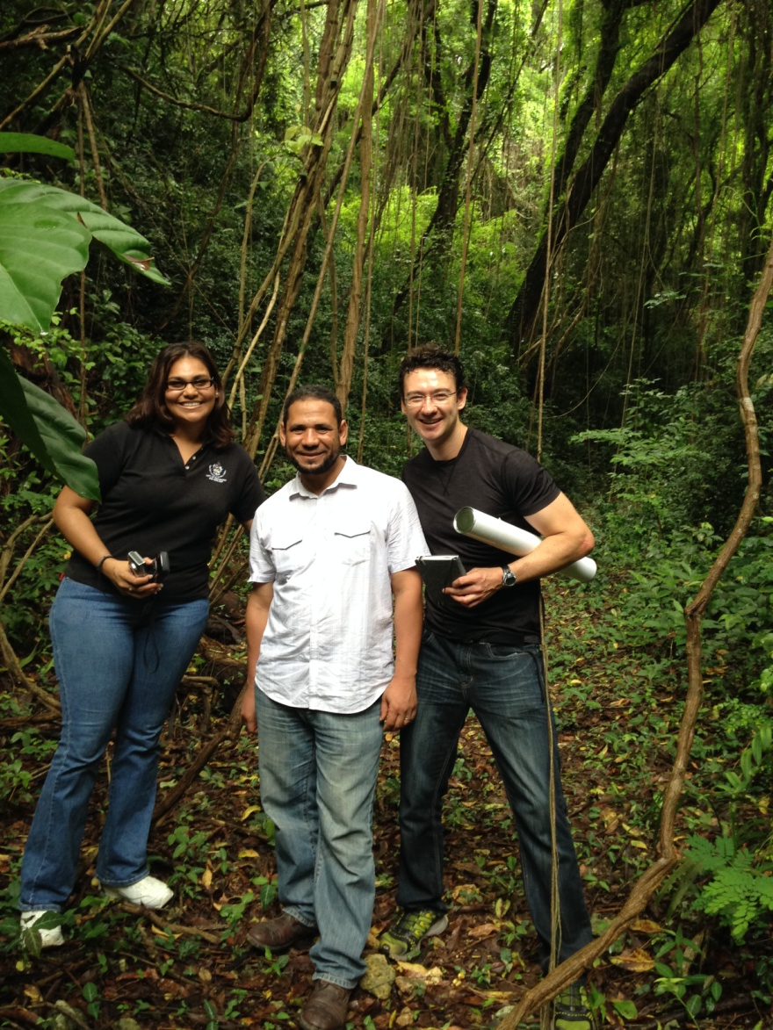

Slide 17
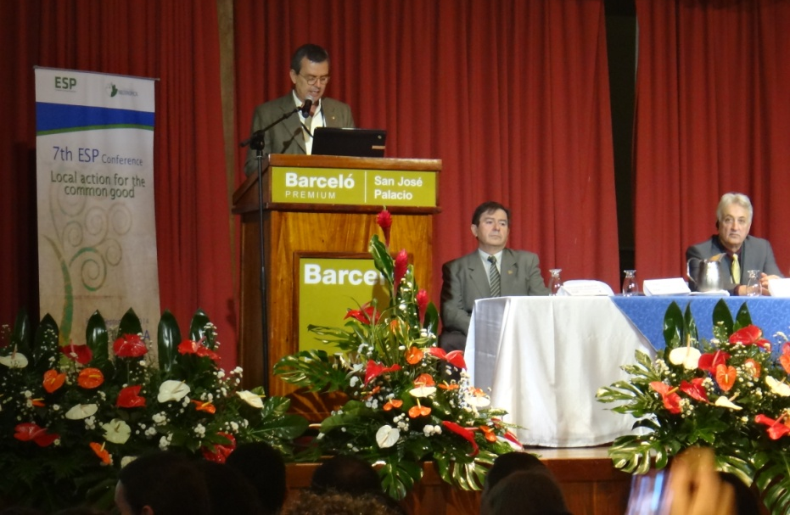
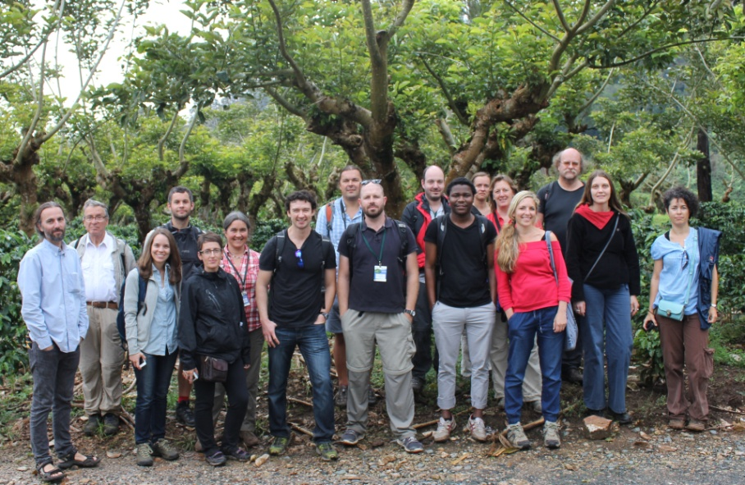
Ecosystem Services Partnership Conference

Slide 18

Take home messages
InVEST and RIOS skillsets
Partnership-building
Multiplier effects
Foundation for PhD

